Slide 1
Теория Информации
В.Н. Ярмолик
Лекция 19
2017

Slide 2
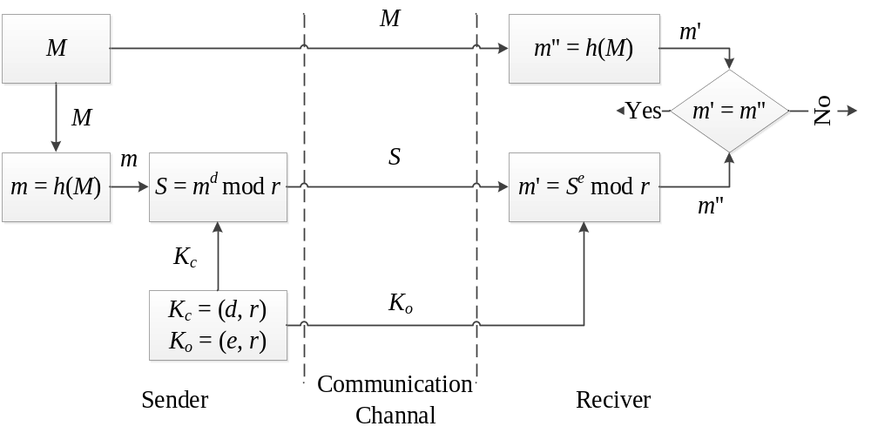
Digital Signature
RSA signature scheme

Slide 3
Digital Signature
ElGamal signature scheme
The ElGamal signature scheme is a digital signature scheme which is based on the difficulty of computing discrete logarithms. It was described by Taher ElGamal in 1984.
One of the variant developed at NSA and known as the Digital Signature Algorithm (DSA) is much more widely used. There are several other variants.
1. Preparation phase
1. H(M) a collision-resistant hash function for message compression have been chosen.
2. P is a large prime such that computing discrete logarithms modulo P is difficult.
3. α<P is a randomly chosen primitive element (generator) of the multiplicative group of integers modulo P .
All these parameters have to be shared between users.

Slide 4
Digital Signature
ElGamal signature scheme
1. Preparation phase cont.
Key generation
4. Randomly select a secret key X with 1< X< P−1.
5. Compute Y = α^{X} mod P.
Public key is (P, α, Y).
Secret key is X.
2. Signature generation (Signing)
To sign a message M the signer performs the following steps.
1. Compress the message H(M) to get the Hash m=H(M).
2. Choose a random K such that 0< K< P−1 and (K, P−1) = 1.
3. Compute W= α^{K} mod P.
4. Compute KV=(m−XW) mod (P−1).
If V=0 start again.
Then the pair (W,V) is the digital signature of M. The signer repeats these steps for every signature.

Slide 5
Digital Signature
ElGamal signature scheme
3. Signature verification
The receiver get the message M with the signature (W,V). Then the message M is verified as follows.
1. Generate the hash value H(M)=m.
2. Compare 0<W<P and 0<V<P−1.
3. Check the equality α^{m=}Y^{W}W^{V} mod P.
The verifier accepts a signature if all conditions are satisfied and rejects it otherwise.
α^{m}=Y^{W}W^{V} mod P
= α^{XW} α^{KV} mod P.
α^{m-XW-KV}= 1 mod P

Slide 6
Digital Signature
Digital Signature Algorithm
The Digital Signature Algorithm (DSA) is a United States Federal Government standard for digital signatures. It was proposed by the National Institute of Standards and Technology (NIST) in August 1991 for use in their Digital Signature Standard (DSS), and adopted in 1993. A minor revision was issued in 1996, in 2000 and again in 2009.
DSA is covered by U.S. Patent 5,231,668, filed July 26, 1991, and attributed to David W. Kravitz, a former NSA employee. This patent was given to "The United States of America as represented by the Secretary of Commerce, Washington, D.C." and the NIST has made this patent available worldwide royalty-free.

Slide 7
Digital Signature
Digital Signature Algorithm
1. Preparation phase
Preparation phase has two steps. The first step is a choice of algorithm parameters which may be shared between different users of the system:
1. H(M) a collision-resistant hash function for message compression have been chosen. Usually it is SHA.
2. Specify L and N length pairs of (1024,160), (2048,224), (2048,256), and (3072,256).
3. Choose an N-bit prime q. N must be less than or equal to the hash output length, for example 160 bit.
4. Generate P is a large prime such that P–1 is a multiple of q. Computing discrete logarithms modulo P is difficult.
5. Choose G, a number whose multiplicative order modulo P is q. This may be done by setting G = h^{(P–1)/q} mod P for some arbitrary h (1 < h < P–1), and trying again with a different h if the result comes out as 1. Most choices of h will lead to a usable G; commonly h=2 is used.
The algorithm parameters (P, G, q) is the public values.

Slide 8
Digital Signature
Digital Signature Algorithm
1. Preparation phase cont.
The second step computes private and public keys for user:
6. Choose the private key X by some random method, where 0<X<q.
7. Calculate the public key Y = G^{X} mod P.
Public values and key are (P, G, q, Y).
Private key is X.

Slide 9
Digital Signature
Digital Signature Algorithm
2. Signature generation (Signing)
To sign a message M the signer performs the following steps.
1. Sender determine the Hash function m=H(M) on electronic documents M, where 1< m< q.
2. Sender randomly generate uniformly distributed no correlated K such that 0< K< q.
3. Calculate r= (G^{K} mod P) mod q.
4. Then with the help of the secret key X sender calculates the integer number S: S=[(m + r·X)/K] mod q.
Recalculate the signature in the unlikely case that r = 0 or S = 0
The pair of numbers r and S creates the Digital signature, thus the signed message represents the three elements, namely (M, r, S).

Slide 10
Digital Signature
Digital Signature Algorithm
3. Signature verification
First of all the receiver based on (M, r, S) have to:
1. Verify the inequalities 0< r< q, 0< S< q. In a case negative result of the verification procedure the digital signature is not valid.
2. Obtain the Hash value m=h(M).
3. Then receiver accomplish the following calculation w=S^{–1} mod q.
4. Calculate the numbers u₁ = (m·w) mod q and u₂= (r·w) mod q.
5. Then with the help of the open key Y receiver perform the following calculations v=((G ^{u1}·Y ^{u2}) mod P) mod q =
= ((G ^{m/S}· G ^{X(r/S)}) mod P) mod q = ((G ^{(m+Xr)/S}) mod P) mod q=
= (G^{K} mod P) mod q. In a case if v=r digital signature is valid.

Slide 11
Digital Signature
Blind Signature
Blind signature, was introduced by David Chaum, as form of digital signature in which the content of a message is closed (blinded) before it is signed. The resulting blind signature can be publicly verified against the original, unblinded message in the manner of a regular digital signature. Blind signatures are typically employed in privacy-related protocols where the signer and message author are different parties. Examples include cryptographic election systems and digital cash schemes.

Slide 12
Digital Signature
Blind Signature
Blind signature schemes can be implemented using a number of common public key signing schemes, for instance RSA and DSA.
1. To perform such a signature, the message is first "blinded", typically by combining it in some way with a random "blinding factor". 2. The blinded message is passed to a signer, who then signs it using a standard signing algorithm.
3. The resulting message, along with the blinding factor, can be later verified against the signer's public key. In some blind signature schemes, such as RSA, it is even possible to remove the blinding factor from the signature before it is verified. In these schemes, the final output (message/signature) of the blind signature scheme is identical to that of the normal signing protocol.

Slide 13
Digital Signature
RSA Blind Signature
There are three party within this scheme, namely:
A the author of the message m to be sign;
N the signing authority, who have to sign the message;
B the verifier.
1. Preparation phase
The signing authority have to generate the public key (D, n) and secret key (E, n), where n=pq.
The signer have to sign s=m^{E} mod n the message m, without the knowledge of m.
2. Signature generation (Signing)
To sign a message m the following steps have to be perform.
1. The author A generate the random value r, such that r is relatively prime to n, (r, n) = 1.
2 The author A is calculated r^{D} mod n, and the resulting value r^{D} mod n is used as a blinding factor.

Slide 14
Digital Signature
RSA Blind Signature
2. Signature generation (Signing) cont.
3. The author A of the message computes the product of the message m and blinding factor, r^{D} mod n i.e.
  m*=m r^{D} mod n.
  4. A sends the resulting value m* to the signing authority N.
  5. The signing authority N then calculates the blinded signature s* as:
    s*=(m*)^{E} mod n = (mr^{D})^{E} mod n.
    6. s* is sent back by N to the author A of the message.
    7. A can then remove the blinding factor to reveal s, the valid RSA signature of m:
      s=s*r⁻¹ mod n = (mr^{D})^{E} r⁻¹ mod n = m^{E}r^{DE}r⁻¹ mod n = m^{E} mod n.

Slide 15
Digital Signature
Proxy Signature
In 1996 Mambo, Usuda and Okamoto proposed the proxy signature scheme. The use A, called original singer, delegate her signing capability to another user, B called the proxy signer.
Proxy signer B can sign the message on behalf of A. A verifier V can validate signature correctness and distinguish between a normal signature and proxy signature. As the result, the verifier can be convinced of the original signer’s agreement on the signed message.
Proxy signature scheme have been suggested for use in a number of application, including electronic commerce, mobile agents, distributed shared object systems and so on.

Slide 16
Digital Signature
Proxy Signature
Proxy signature scheme is based on the Discrete Logarithm Problem (DLP) for a cyclic multiplicative group G_{p} generated by α of order p. There are not probabilistic polynomial-time algorithm to get the value x from α^{x} mod p.
1. Preparation phase
The following parameter have to define:
1. Public Hash function H(M).
2. p is large prime number.
3. α generating element.
The original signer A
1. The original signer A generate his private key x and calculate the public key y=α^{x} mod p.
2. The original signer randomly generate the value k and make the calculation r=α^{k} mod p.

Slide 17
Digital Signature
Proxy Signature
1. Preparation phase
The original signer A cont.
3. The original signer A calculate s=x+kr mod p–1.
2. A sends (r, s) to the proxy signer B.
The proxy signer B.
1. The proxy signer B checks the validity of (r, s) using next equality
α^{s}=yr^{r} mod p
α^{(x+kr) mod p–1}=α^{x}(α^{k})^{r} mod p
α^{(x+kr)-((x+kr) mod (p-1)}= 1 mod p
If the equality holds, the proxy signer accepts (r, s) as valid proxy secret key. If not, the protocol stops.

Slide 18
Digital Signature
Proxy Signature
2. Signature generation (Signing)
1. The proxy signer B signs the message M representing as m=H(M) based on the value s=x+kr mod p–1. As signature generation algorithm the ElGamal algorithm can be used.
2. After that, the proxy signer sends the message M with the signature (S_{pr}, r) to the verifier V.
3. Signature verification
The verifier V based on (M, r, S_{pr}) have to:
1. Verifier recovered the public key y_{pr} of the proxy signer according to the following calculations y_{pr}=yr^{r} mod p=α^{x}(α^{k})^{r} mod p=α^{s} mod p.
After that, the verifier V performs the verification phase of the normal signature scheme.

Slide 19
Digital Signature
Group Signature
A Group signature scheme is a method for allowing a member of a group to anonymously sign a message on behalf of the group. The concept was first introduced by David Chaum and Eugene van Heyst in 1991.
For example, a group signature scheme could be used by an employee of a large company where it is sufficient for a verifier to know a message was signed by an employee, but not which particular employee signed it.
Essential to a group signature scheme is a group manager, who is in charge of adding group members and has the ability to reveal the original signer in the event of disputes. In some systems the responsibilities of adding members and revoking signature anonymity are separated and given to a membership manager and revocation manager respectively.

Slide 20
Digital Signature
Ring Signature
A ring signature is a type of digital signature that can be performed by any member of a group of users that each have keys. Therefore, a message signed with a ring signature is endorsed by someone in a particular group of people. One of the security properties of a ring signature is that it should be difficult to determine which of the group members' keys was used to produce the signature. Ring signatures are similar to group signatures but differ in two key ways: first, there is no way to revoke the anonymity of an individual signature, and second, any group of users can be used as a group without additional setup. Ring signatures were invented by Ron Rivest, Adi Shamir and Yael Tauman, and introduced at ASIACRYPT in 2001. The name "ring signature" comes from the ring-like structure of the signature algorithm.

